Slide 1
Data Warehousing
BASIC CONCEPTS
ANURIMA MALIK
380053
EIM | LS

Slide 2
DW DEFINITION
A data warehouse is a subject-oriented, integrated, time-variant and non-volatile collection of data in support of management's decision making process.
SUBJECT-ORIENTED: A data warehouse can be used to analyze a particular subject area (Eg- Sales)
INTEGRATED: A data warehouse integrates data from multiple data sources
TIME-VARIANT: Stores historical data
NON-VOLATILE: Data in DW will not change. So, historical data in a data warehouse should never be altered.

Slide 3
TERMINOLOGIES
DATA MART:
i) A data mart serves the same role as a data warehouse, but it is intentionally limited in scope.
ii) Logical subset of the complete data warehouse
iii) It may serve one particular department or line of business.
iv) The advantage of a data mart versus a data warehouse is that it can be created much faster due to its limited coverage.
OPERATIONAL DATA SOURCE (ODS):
i) Operational data stores exist to support daily operations. The ODS data is cleaned and validated, but it is not historically deep; it may contain just the data for the current day.
ii) It gives data warehouses a place to get access to the most current data, which has not yet been loaded into the data warehouse.

Slide 4
TERMINOLOGIES
OLTP (ONLINE TRANSACTION PROCESSING)
Online Transaction Processing is a information system type that prioritizes transaction processing, dealing with operational data. This kind of computer systems are identified by the large number of transactions they support, making them the best to address online application.
On the database level, these transactional systems base their operation on multi-access, fast and effective queries to the database. The most used operations are INSERT, UPDATE and DELETE, since they are directly modifying the data, providing new information on new transactions. So, in these systems, data is frequently updated, requiring a effective write operations support.
One special characteristic of those databases is the normalization of it’s data. This happens because data normalization provides a faster and more effective way to perform database writes. The main concern is the atomicity of the transactions and ensuring that concurrent accesses don’t damage data and also don’t degrade system’s performance.
Real World Example: A banking transaction system is a classic example. There are many users executing operations into their accounts and the system must guarantee the completeness of the actions. In this case there are several concurrent transactions at the same time, being data coherence and efficient operations the main goal.

Slide 5
OLAP (ONLINE ANALYTICAL PROCESSING)
It refers to systems focused on analyzing data in a specific database. This kind of systems are characterized for their analytical capabilities, addressing multi-dimensional or one dimension data, processing all the information. The standard applications of OLAP are business intelligence, data writing and reporting.
On the database level, these systems operation is defined by a low level of transactions, dealing with archived and historical information. This data is seldom updated, identifying the SELECT database operation as the key feature of the system. Therefore, this kind of databases are based on READ operations, aggregating all available information.
Real World Example: In a hospital there is 20 years of very complete patient information stored. Someone on the administration wants a detailed report of the most common diseases, success rate of treatment, internship days and a lot of relevant data. For this, we apply OLAP operations to our data warehouse with historical information, and thorough complex queries we get these results. Then they can be reported to the administration for further analysis.

Slide 6
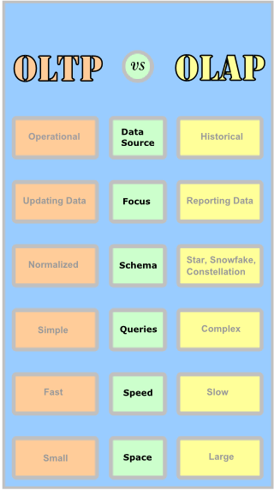
OLAP vs OLTP

Slide 7
OLAP vs OLTP
CATEGORY | ONLINE TRANSACTIONAL PROCESSING | ONLINE ANALYTICAL PROCESSING
Data Source | Operational information of the application. Generally this processes are the source of the data. | Historical and archive data.
Focus | Updating data. | Reporting and retrieval of information.
Data Refresh | Insert, update and delete operations. They are performed fast. Immediate results. | Refreshing of data with huge data sets. Takes time and is sporadic.
Data Model | Entity-relantionship on databases. | One or multi-dimensional data.
Schema | Normalized schemas. Many tables and relationships. | Star, snowflake and constellation schema. Fewer tables not normalized.
Horizon | Day-to-day, weeks, months. | Long time data.
Queries | Simple, returning the results expected for the system activity. | Complex queries of data in order to aggregate information for reporting.
Speed | Fast. Requires some indexes on large tables. | Slow. Depending on the amount of data. Requires more indexes.
Space | Operational data stored, tipically small. | Large data sets of historical information. Large storage needed.

Slide 8
Facts/Dimensions
FACT
  Central, dominant table
  Multi-part primary key
  Holds millions & billions of records
  Links directly to dimensions
  Stores business measures
  Constantly varying data
DIMENSIONS
  Single join to the fact table (single primary key)
  Stores business attributes
  Organized into hierarchies
  More or less constant data
  E.g. Time, Product, Customer, Store, etc.

Slide 9
Facts/Dimensions
EXAMPLE:
Suppose a company sells products to customers. Every sale is a fact that happens within the company and the fact table is used to record these facts.
FACT TABLE:
CUSTOMER DIMENSION TABLE:
Time_ID | Product_ID | Customer_ID | Unit Sold
4 | 17 | 2 | 1
8 | 21 | 3 | 2
8 | 4 | 1 | 1
CustomerID | Name | Gender | Income | Education | Region
1 | Brian Edge | M | 2 | 3 | 4
2 | Fred Smith | M | 3 | 5 | 1
3 | Sally Jones | F | 1 | 7 | 3
Row 2 in the fact table records the fact that customer 3 (Sally Jones) bought two items on day 8.

Slide 10
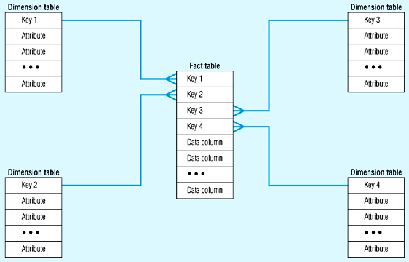
STAR SCHEMA
In the star schema design, a single object (the fact table) sits in the middle and is radically connected to other surrounding objects (dimension lookup tables) like a star.
Each dimension is represented as a single table.
The primary key in each dimension table is related to a foreign key in the fact table.

Slide 11
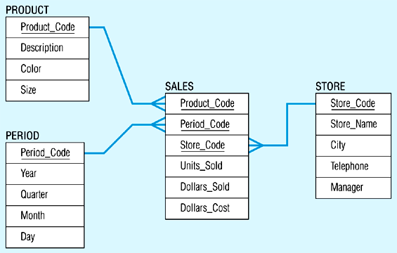
Star schema example

Slide 12
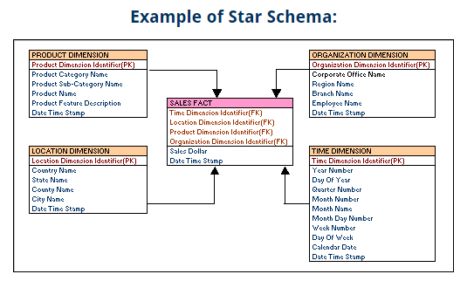

Slide 13
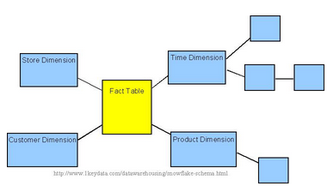
SNOWFLAKE SCHEMA
The snowflake schema is an extension of the star schema, where each point of the star explodes into more points.
In a star schema, each dimension is represented by a single dimensional table, whereas in a snowflake schema, that dimensional table is normalized into multiple lookup tables, each representing a level in the dimensional hierarchy.
For example, the Time Dimension that consists of 2 different hierarchies:
1. Year → Month → Day
2. Week → Day

Slide 14
Snowflake schema example
Store Dimension
District_ID
Region_ID
STORE KEY
District Desc.
Region_ID
Region Desc.
Regional Mgr.
Store Description
City
State
District ID
District Desc.
Region_ID
Region Desc.
Regional Mgr.
Store Fact Table
STORE KEY
PRODUCT KEY
PERIOD KEY
Dollars
Units
Price

Slide 15
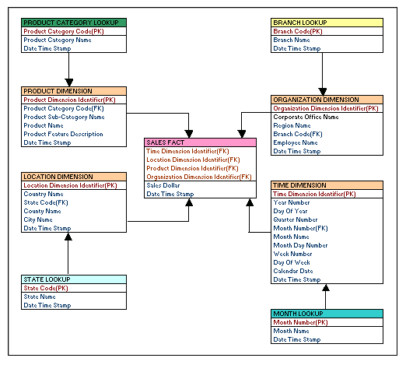
Snowflake schema example

